Slide 1
Group 27
Project presentation: WINX
Boffo Marco,
Brusadin Giulia,
Camporese Maria,
Morettini Simone
Course of Modelling and Simulation of Mechatronic Systems A.Y. 2019/2020
University of Trento

Slide 2
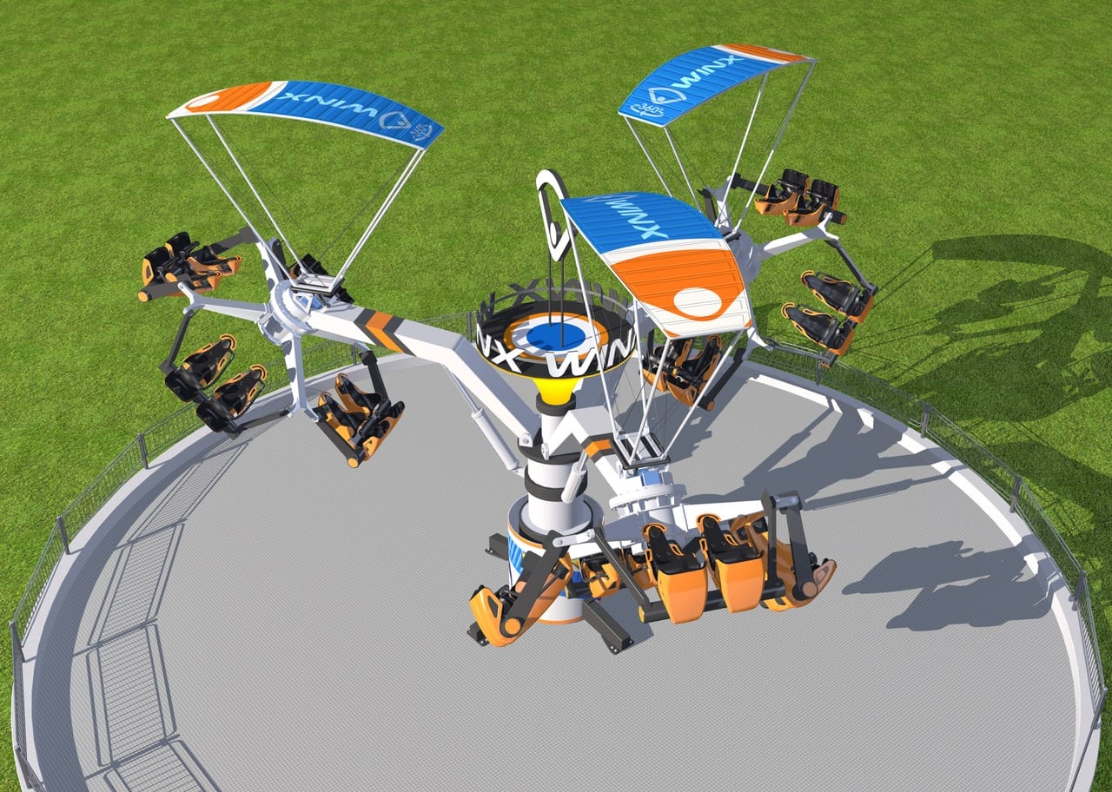
Index
Engineering specifications
Kinematic analysis
Recursive approach
Global approach
Dynamic analysis
Maple
MatLab
MapleSim

Slide 3
Engineering
specifications

Slide 4
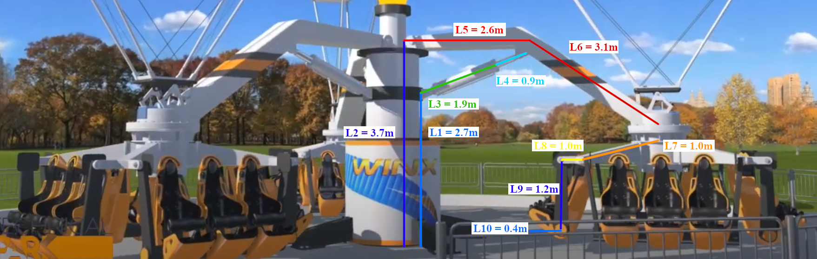
Dimensions
We have tried to keep the same proportions of the given 3D rendering and to obtain similar dimension to the ones of a similar attraction

Slide 5
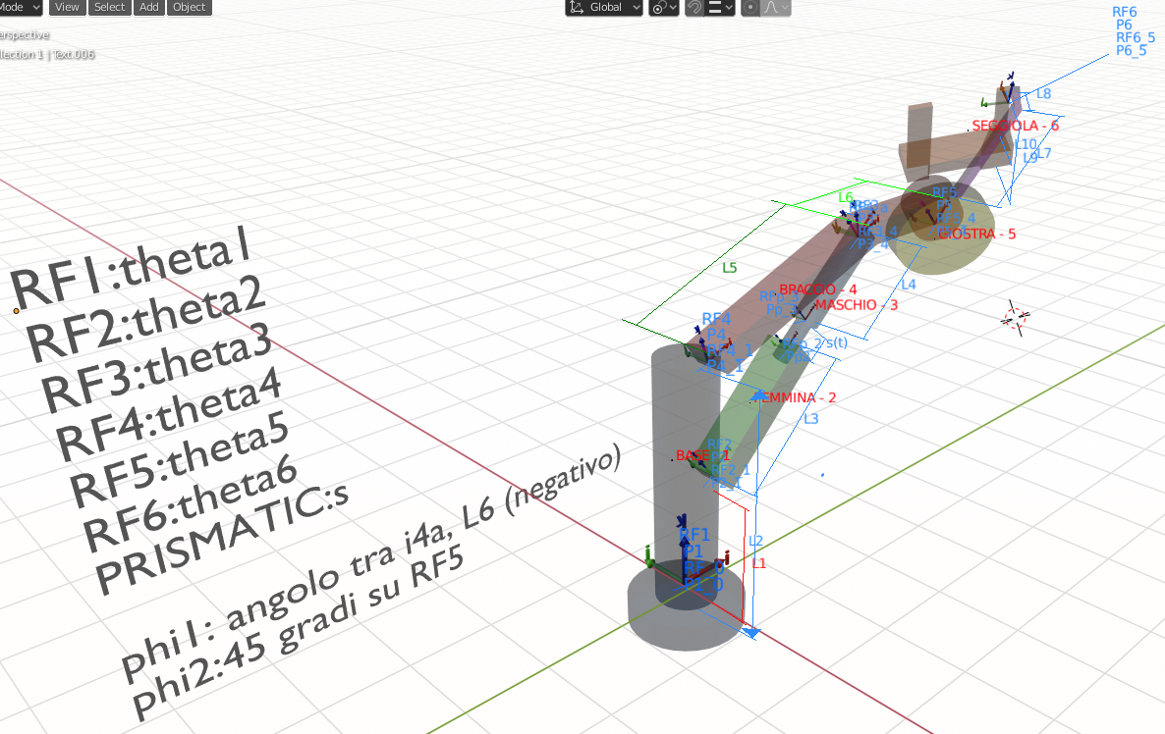
Model for reference

Slide 6
Objectives
System Requirement | Engineer specification | Target performance | Weight
Safety: avoid nausea, vision disruption, cardiovascular problems and give chance to brace | Follow the limits imposed on [Table1] | Acceleration below the values expressed in [Table1] | 4
Fun: high speed, atypical physical experience and change the user perspective | Maximize fun function |  | 3
Durability | Diminish stress on the structure | Minimize jerk | 2
Occupied space | Contained working space dimension | 20x20m (minimize if possible) | 1

Slide 7
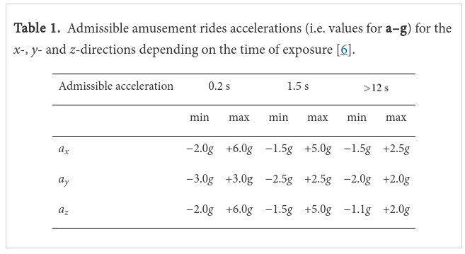
Ranges of admissible accelerations
[Table1]Eager, David, Ann-Marie Pendrill, and Nina Reistad.
"Beyond velocity and acceleration: jerk, snap and higher derivatives."
European Journal of Physics 37.6 (2016): 065008

Slide 8
Kinematic analysis

Slide 9
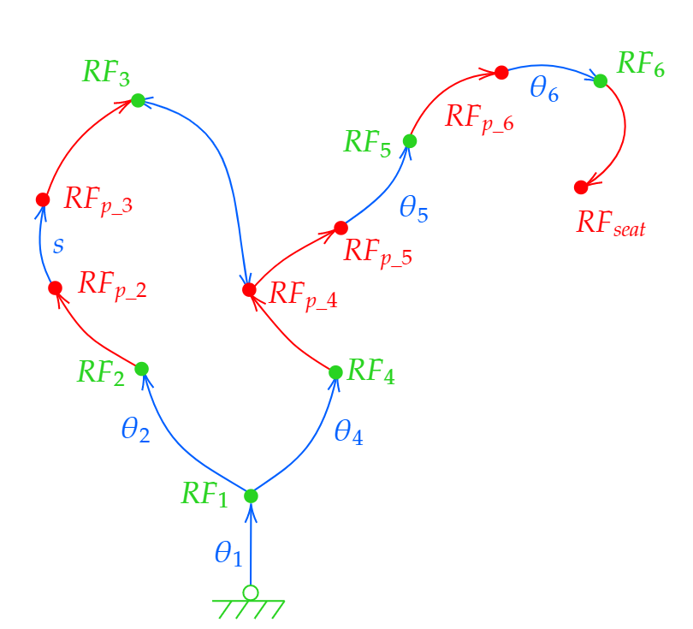
Recursive Approach
We defined the body reference frames in recursive formulation.
Since there is a loop in the system, we added two constraint equations, derived from the overlapping of the origin of two reference frames.
We then used rehonomous constraints in the kinematic analysis, leaving time as the only independent variable.

Slide 10
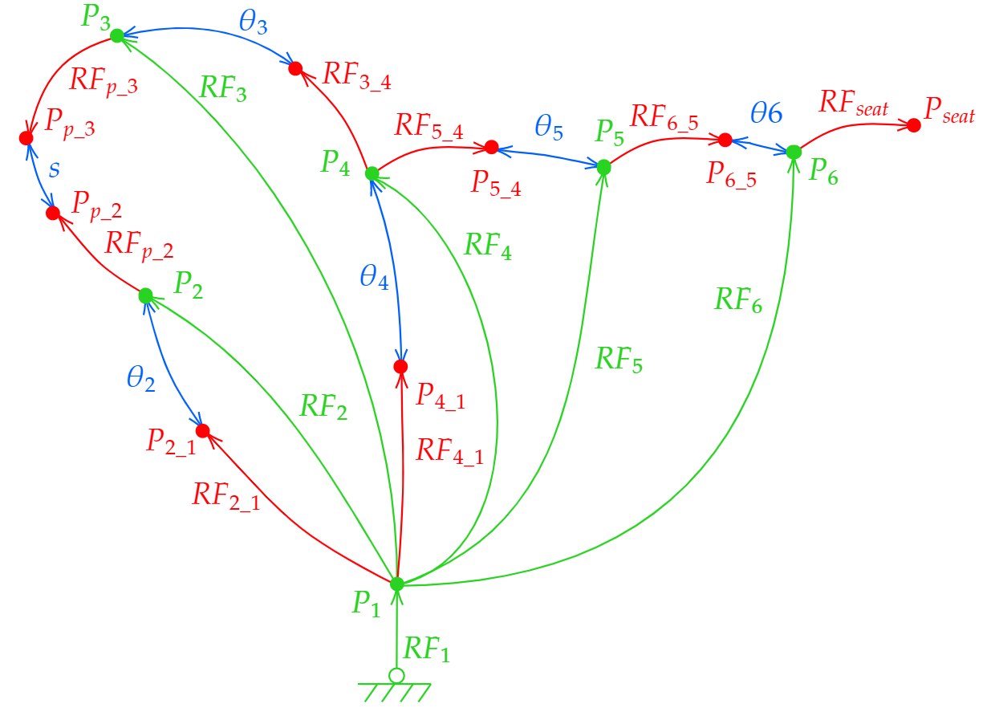
Global Approach
We defined the simplified method, maintaining the proper global formulation.
We obtain, in the end, 21 variables, of which 17 are dependent. Therefore, we have 17 constraint equations.
We then used rehonomous constraints in the kinematic analysis, leaving time as the only independent variable.

Slide 11
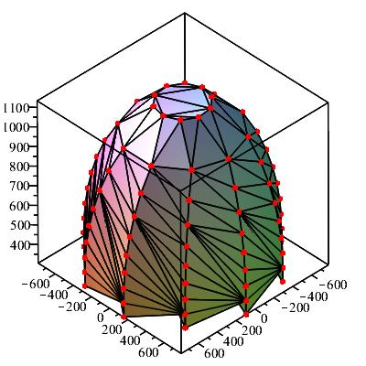
Workspace
The workspace, calculated as the maximum space occupied by the traction, is:
along X from -778 cm to 778 cm
along Y from -787 cm to 787 cm
along Z from ground to 1133

Slide 12
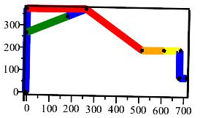
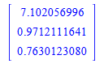
Initial position problem
Recursive
The system has proven to be simple enough to use the analytical approach.
Global Due to the complexity and number of the constraints we decided to use the numerical solution.
Seat Position at beginning: [m]
Results s(t) = 0 cm, θ1(t) = 0 rad, θ5(t) = 0 rad, θ6(t) = 0 rad
θ2(t) = arcsin(0.381) = 0.391 rad
θ4(t) =arctan(0.00678, 0.999)}= 0.00678 rad

Slide 13
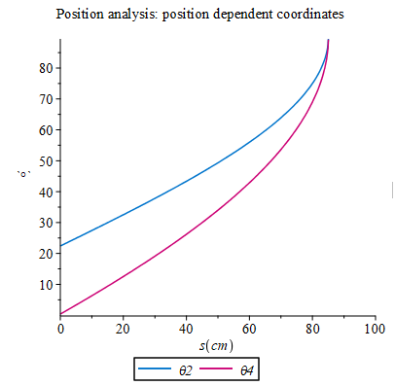
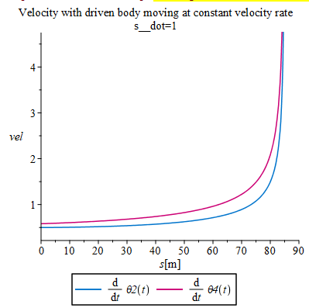
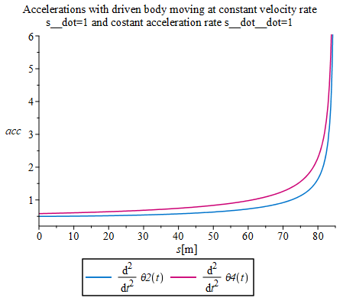
Singular Configuration

Slide 14
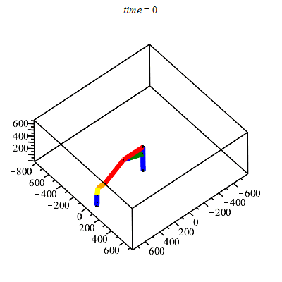
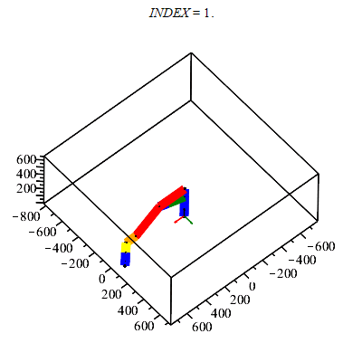
Profiles Animation
s_profile_time := alpha__s - alpha__s*cos(omega__s*t); theta1_profile_time := omega__1*t; theta5_profile_time := omega__5*t; theta6_profile_time := alpha__6*sin(omega__6*t);
Recursive approach (Analytical of 30 of 180 sec)
Global approach (Numerical of 30 of 180 sec)

Slide 15
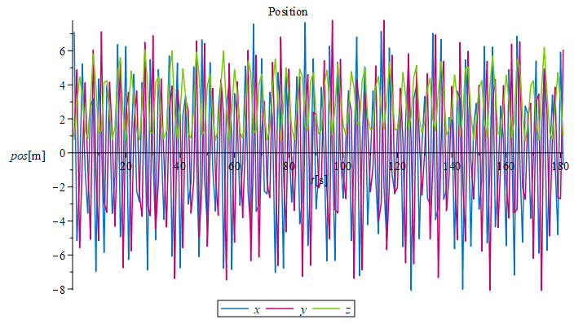
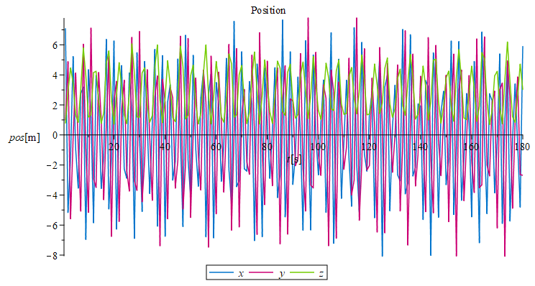
Position analysis of the seat from the ground
Recursive approach Analytical
Global approach Numerical

Slide 16
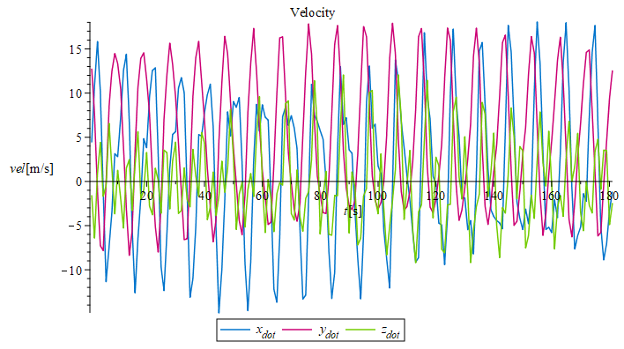
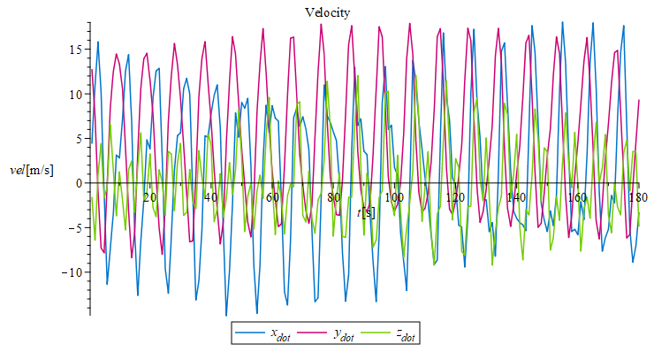
Velocity analysis of the seat
Recursive approach Analytical
Global approach Numerical

Slide 17
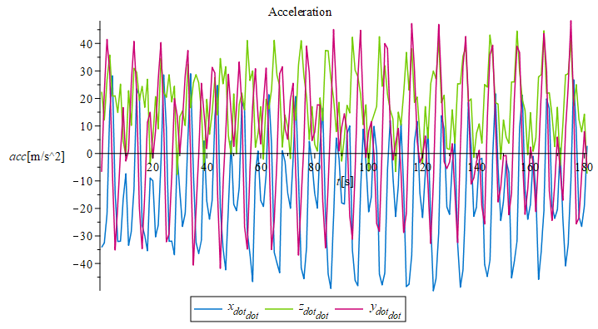
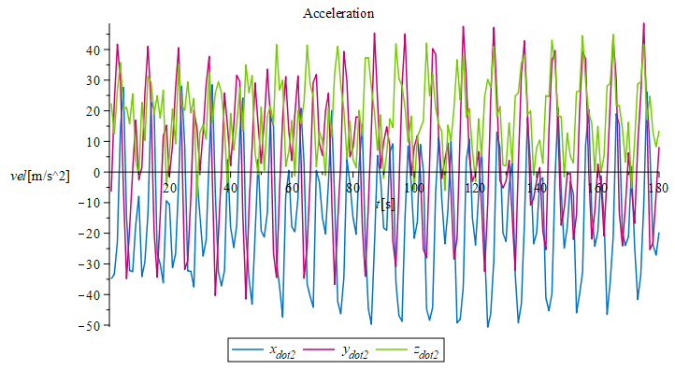
Acceleration analysis of the seat
Recursive approach Analytical
Global approach Numerical

Slide 18
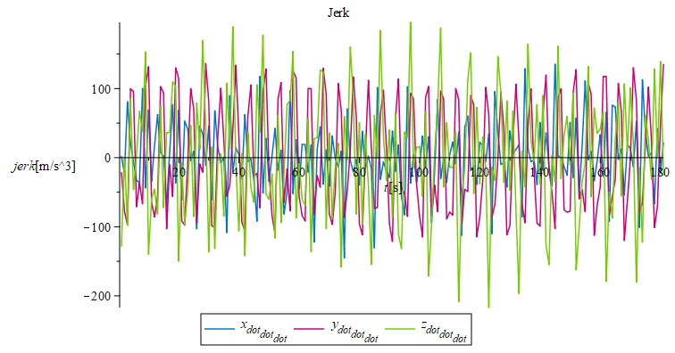
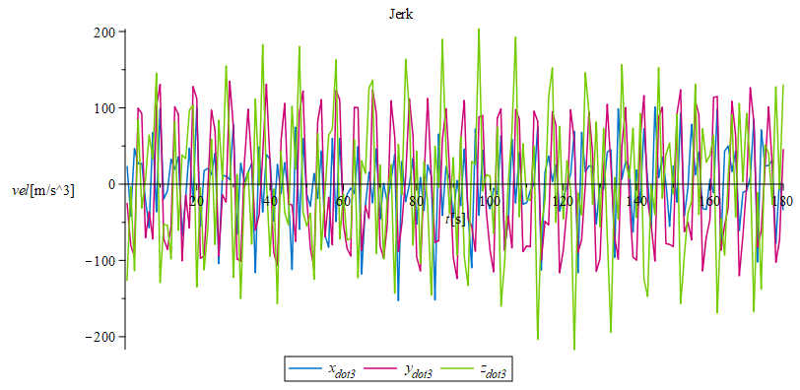
Jerks analysis of the seat
Recursive approach (using splines)
Global approach (using splines)

Slide 19
Fitness function
It mix three different function
Durability: sum of jerks obtained;
Safety: seconds where the acceleration of the seat is above the threshold following [Table1]
Fun: seconds where the velocity of the seat it’s above 40 km/h
They are all mixed in one weighted sum
TotalFitness= -1*sec_vel_x_h+-1.2*sec_vel_x_l+-1.1*sec_vel_z_h+-1*sec_vel_z_l +1000*sec_not_safety +0.0001*avg_jerk

Slide 20
Montecarlo analysis
For each parameter of the motion profiles (rehonomous constraints) α_{s}, ω_{s}, ω₁, ω₅, ω₆ we gave a reasonable interval in which we operated the Monte Carlo Analysis. Such analysis consists in trying different values, chosen randomically in an interval, to determine which ones influence more a given function.
Standard deviation of the fitness function changing the parameters:
α_{s}= 0.00176044505695813
ω₁= 0.000977420386241434
ω₅= 13937.1927683439
ω₆= 634.670170016884
ω_{s}= 17485.4200887781
ω_{s} is the parameter that influence more the performance indices.

Slide 21
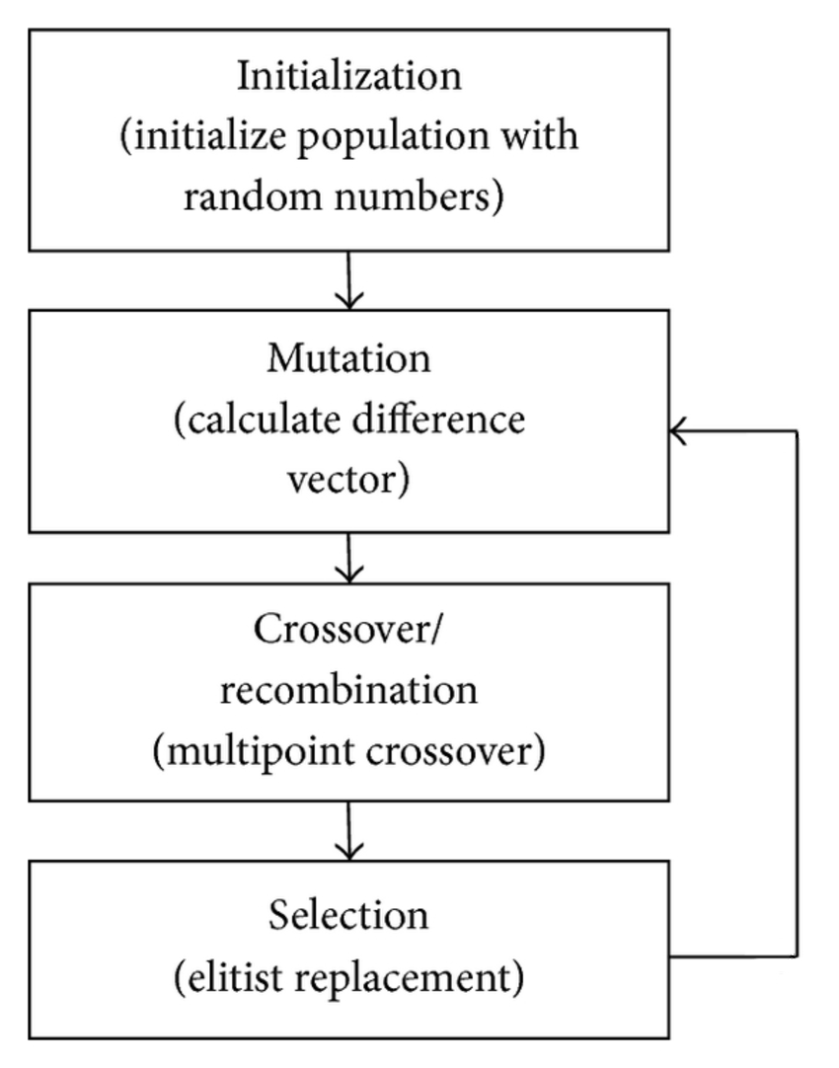
Optimization
The parameters are optimized using Differential Evolution, a particular kind of Evolutionary Algorithms. The objective was to minimize the fitness function.
Every individual of the population is composed by the parameter of the profiles (α_{s}, ω_{s}, ω₁, ω₅, ω₆).

Slide 22
Confrontation with target values
After the optimization we obtained the following:
Reached targets
Velocity above 40 km/h or under -40 km/h along x for 36.2 seconds. The target was 30s
Acceleration always within safety limits
Dimensions within 20x20m
Missed targets
Velocity above 40 km/h or under -40 km/h along z for 3.5 seconds. The target was 10s

Slide 23
Dynamic analysis

Slide 24
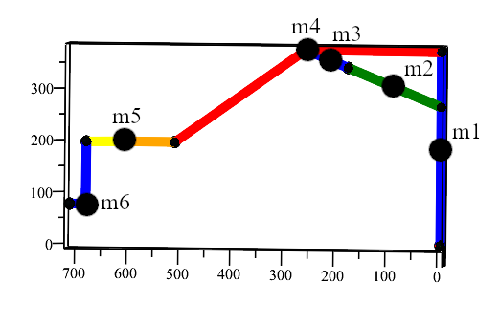
Weights estimate
We decided to develop a first approximation using point masses distributed as in the picture.
masses:={m1=300,m2=500,m3=500,m4=4000,m5=750,m6=150}:
Hence we considered only one non-zero component of the inertia tensor for each mass:
inertias:={IZ1=((L2/2)^2)*m1, IX2=((L3/2)^2)*m3, IX3=((L4/2)^2)*m3, IX4=((L5/2)^2)*m4, IX5=((L7/2)^2)*m5, IZ6=((L9/2)^2)*m6}

Slide 25
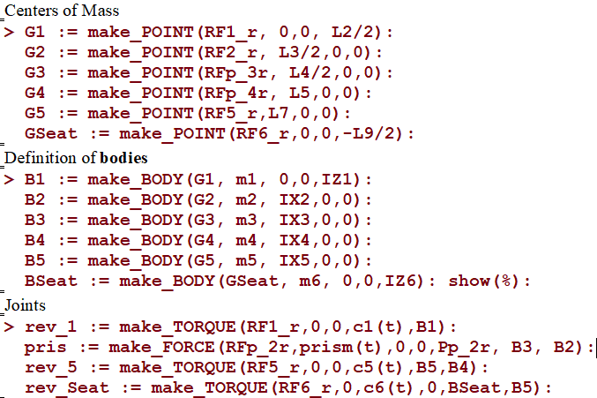
Dynamic analysis - Definition of the system
First we defined masses and inertia tensors
Then we defined the centers of mass and all the bodies
After this, we defined the joints and relative forces and torques
Finally, we used the command _gravity to add gravitational forces

Slide 26
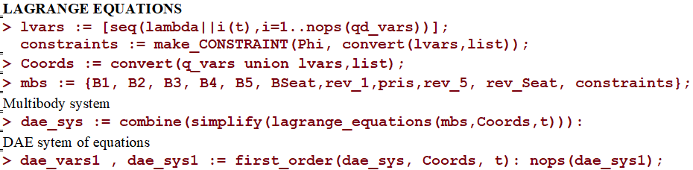
Dynamic analysis with Lagrange approach
To develop the dynamic analysis of the system, we used the Lagrange approach. To generate the Lagrange equations, we added the kinematic constraints and defined the MBS

Slide 27
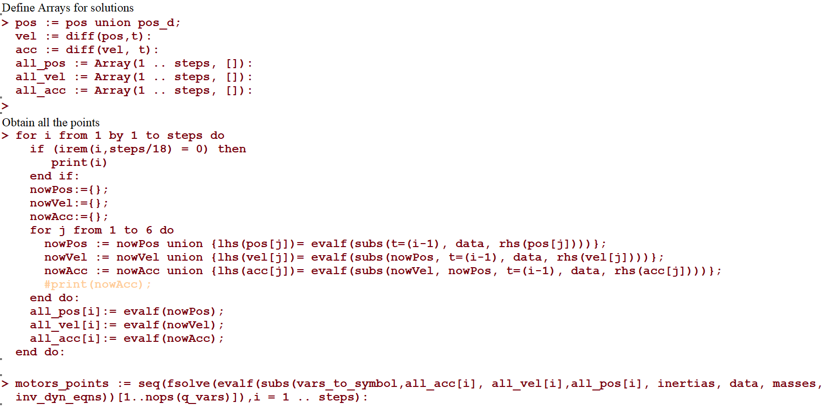
Inverse Dynamic
Using positions, velocities and accelerations from kinematics (using a time-step of 1s/0.1s), we obtained forces and torques from the DAE

Slide 28
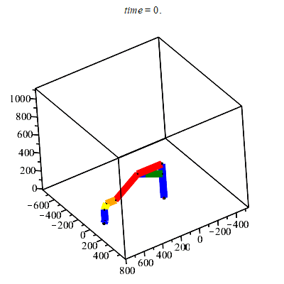
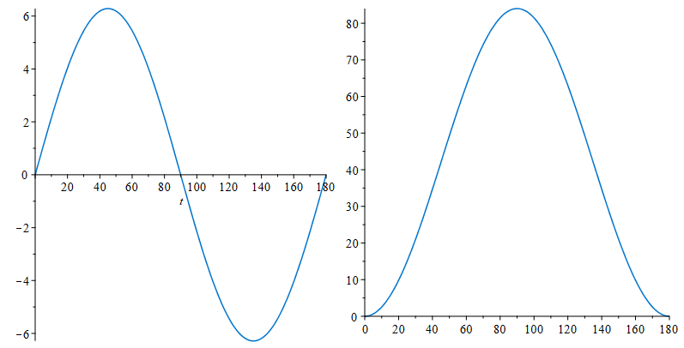
Simple profiles for Dynamics
Revolutes Prismatic

Slide 29
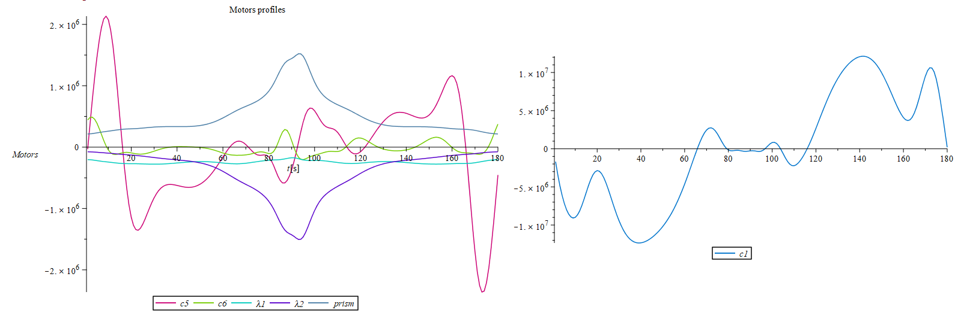
Motor Profiles

Slide 30
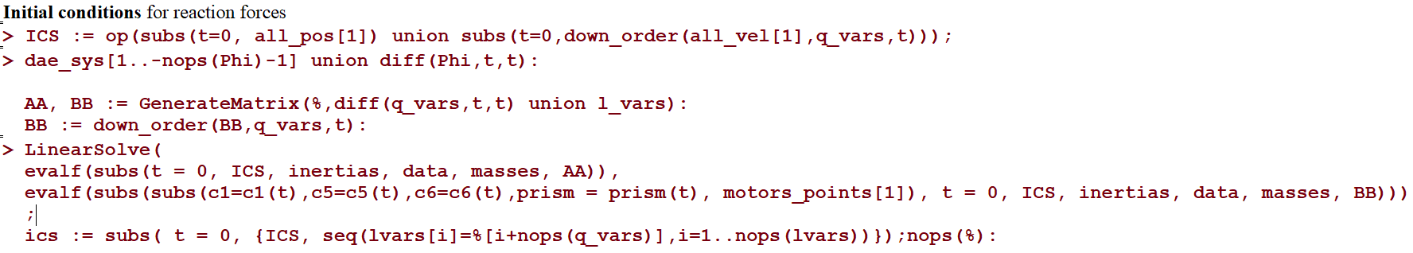
Initial Conditions
Starting from the motion profiles described before, we computed the initial conditions using the DAE system

Slide 31
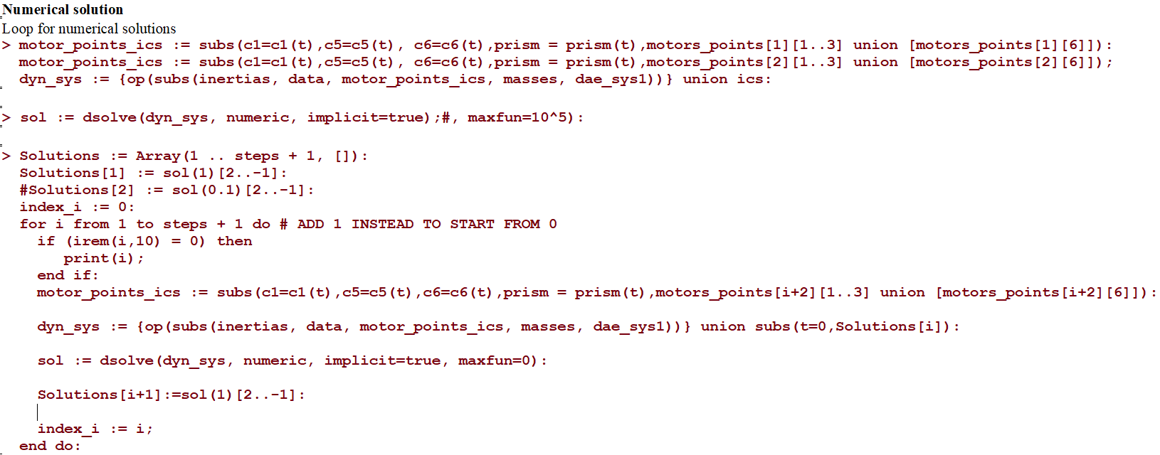
Numerical Solution
With the initial conditions and the values for the motors obtained before, we computed the solutions for the variables substituting them at each step using the following loop

Slide 32
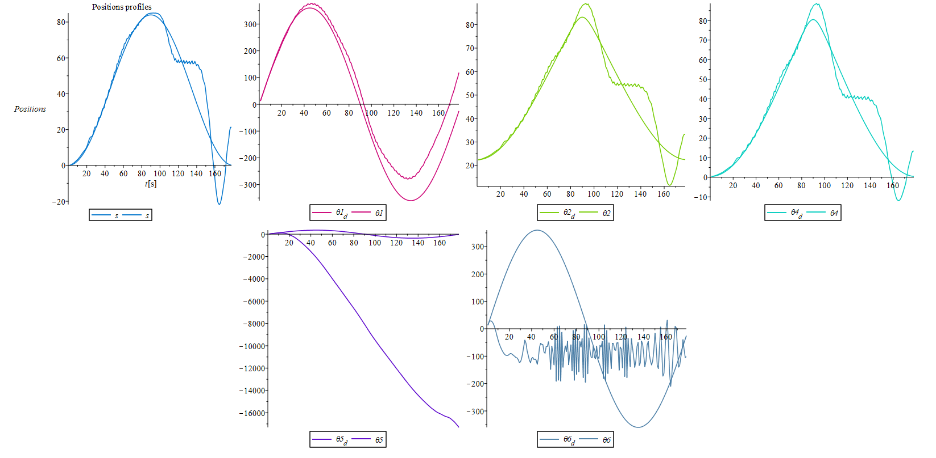
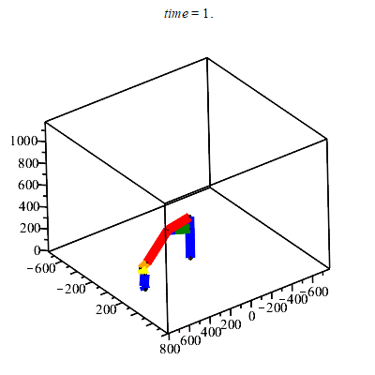
Plots (180 steps)

Slide 33
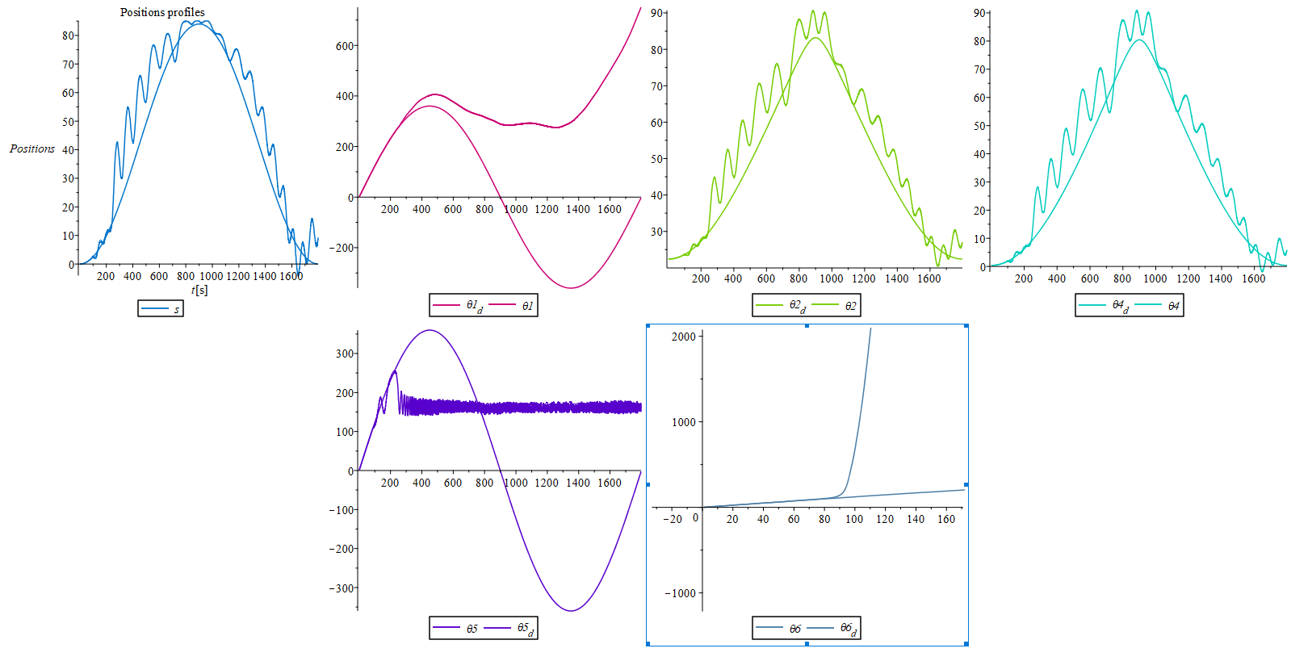
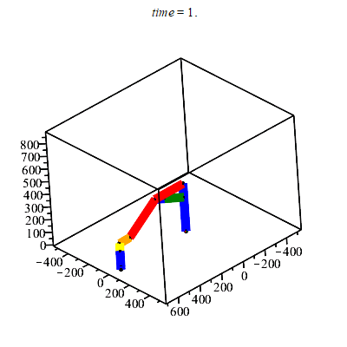
Plots (1800 steps)

Slide 34
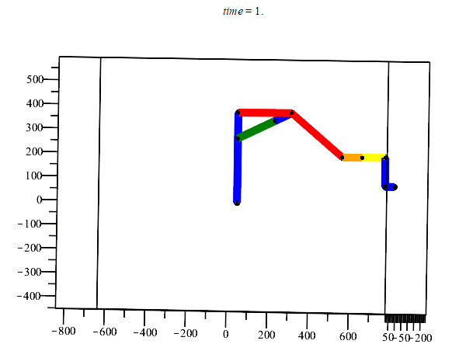
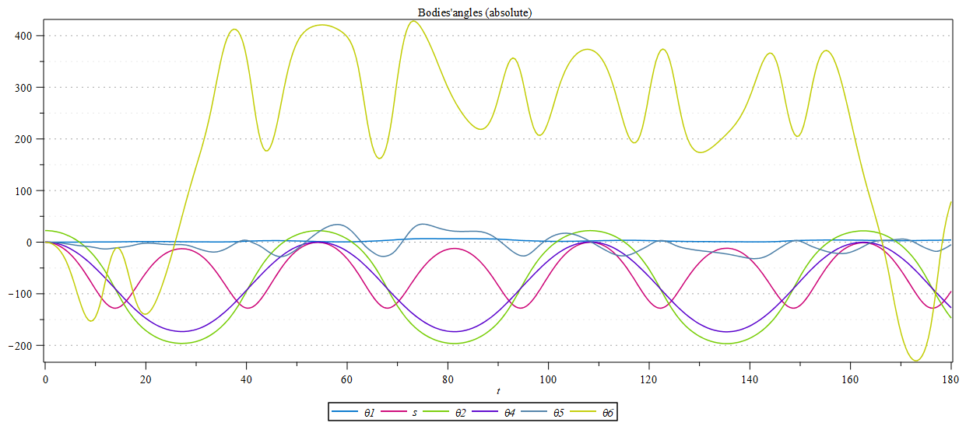
Static Dynamics
Imposing zero forces and torques we obtain:

Slide 35
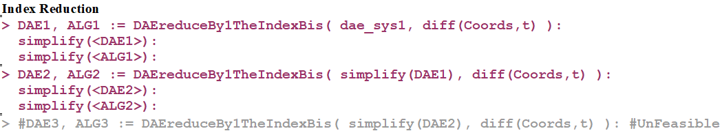
Index Reduction
Using the library given by prof. Bertolazzi, we were able to reach the Index1 DAE, but the last step to obtain the ODE using Index reduction was not able to finish its execution

Slide 36
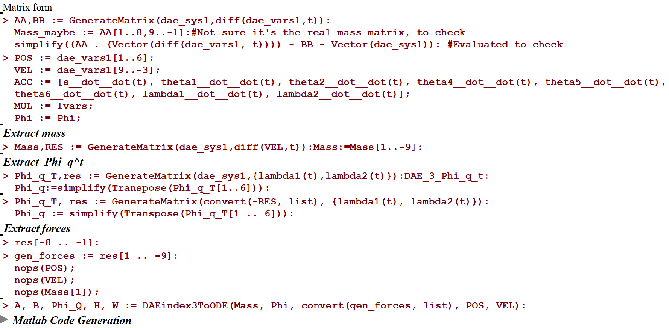
Standard Approach
From DAE3 to ODE using Bertolazzi’s Maple library latest version

Slide 37
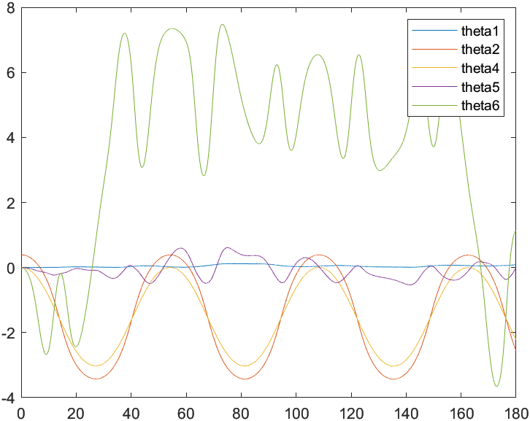
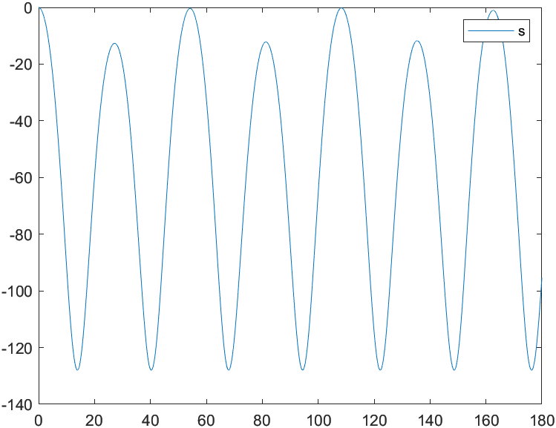
Resolution of ODE in Matlab with Projection
To implement the Winx(Winx.m) we used the ODEbaseClass_P from the toolbox of prof. Bertolazzi.
All the matrices are created using DAEindex3ToODE and exported using the functions from DAE-lib.maplet.
Coordinates evaluated using Heun numerical method with projection and all torques and forces set to zero.

Slide 38
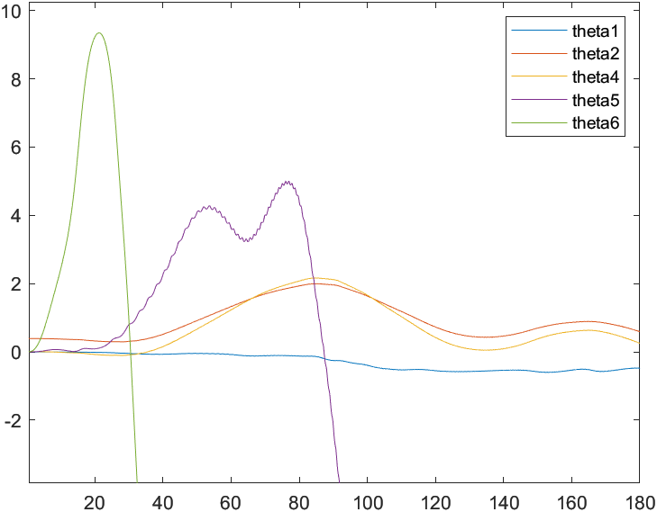
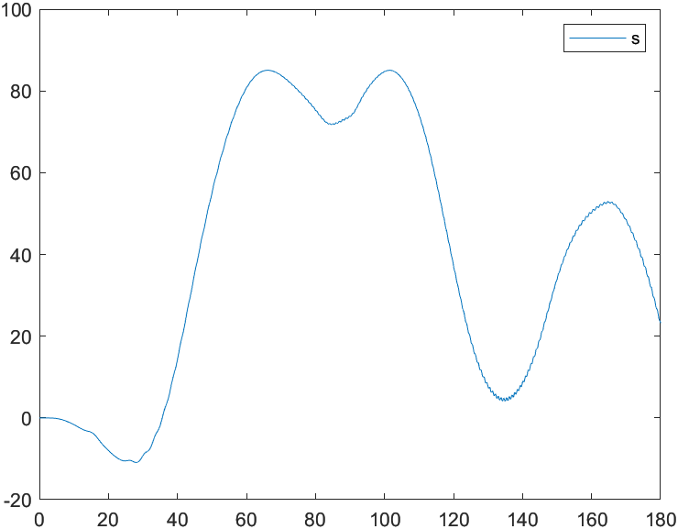
Resolution of ODE in Matlab with Projection
Coordinates evaluated using Heun numerical method with projection using motor profiles obtained from inverse dynamic

Slide 39
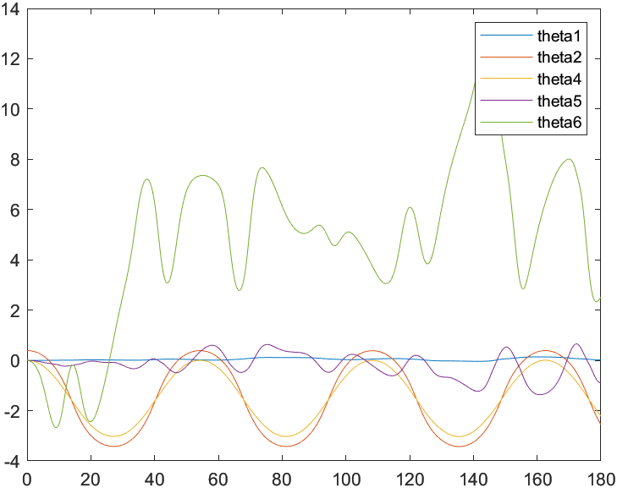

Resolution of DAE in Matlab with Baumgarte
To implement the Winx (WinxDAE.m) we used the DAE3baseClassImplicit that represents a DAE equation and Baumgarte stabilization with 𝜂 = 0.5 and ⍵= 4. All torques and the prismatic force are fixed to 0.

Slide 40
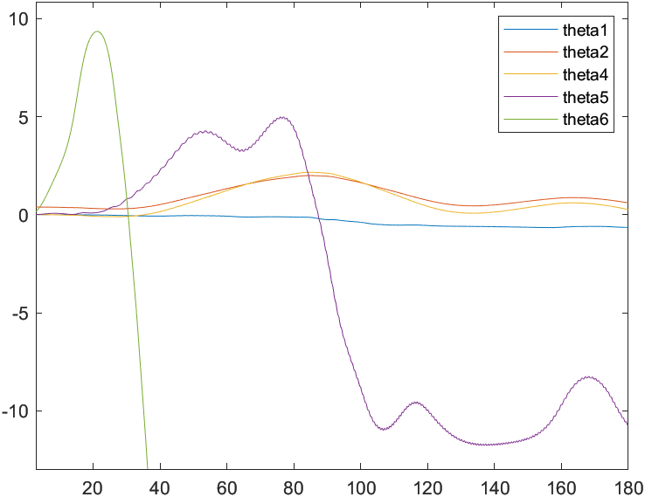
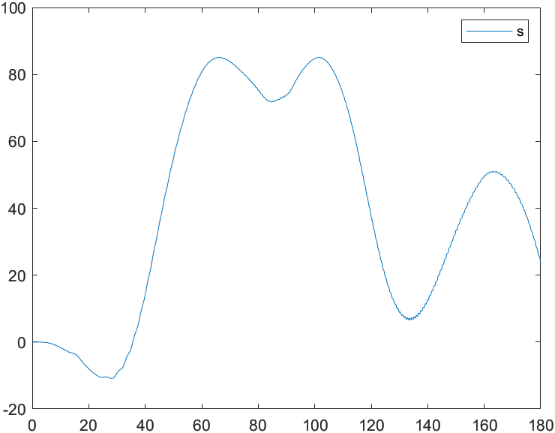
Resolution of DAE in Matlab with Baumgarte
Profile obtained by using Winx(WinxDAE.m) that represent a DAE equation and Baumgarte stabilization with 𝜂 = 0.5 and ⍵= 4. The motor profiles used are the ones obtained from the inverse dynamic.

Slide 41
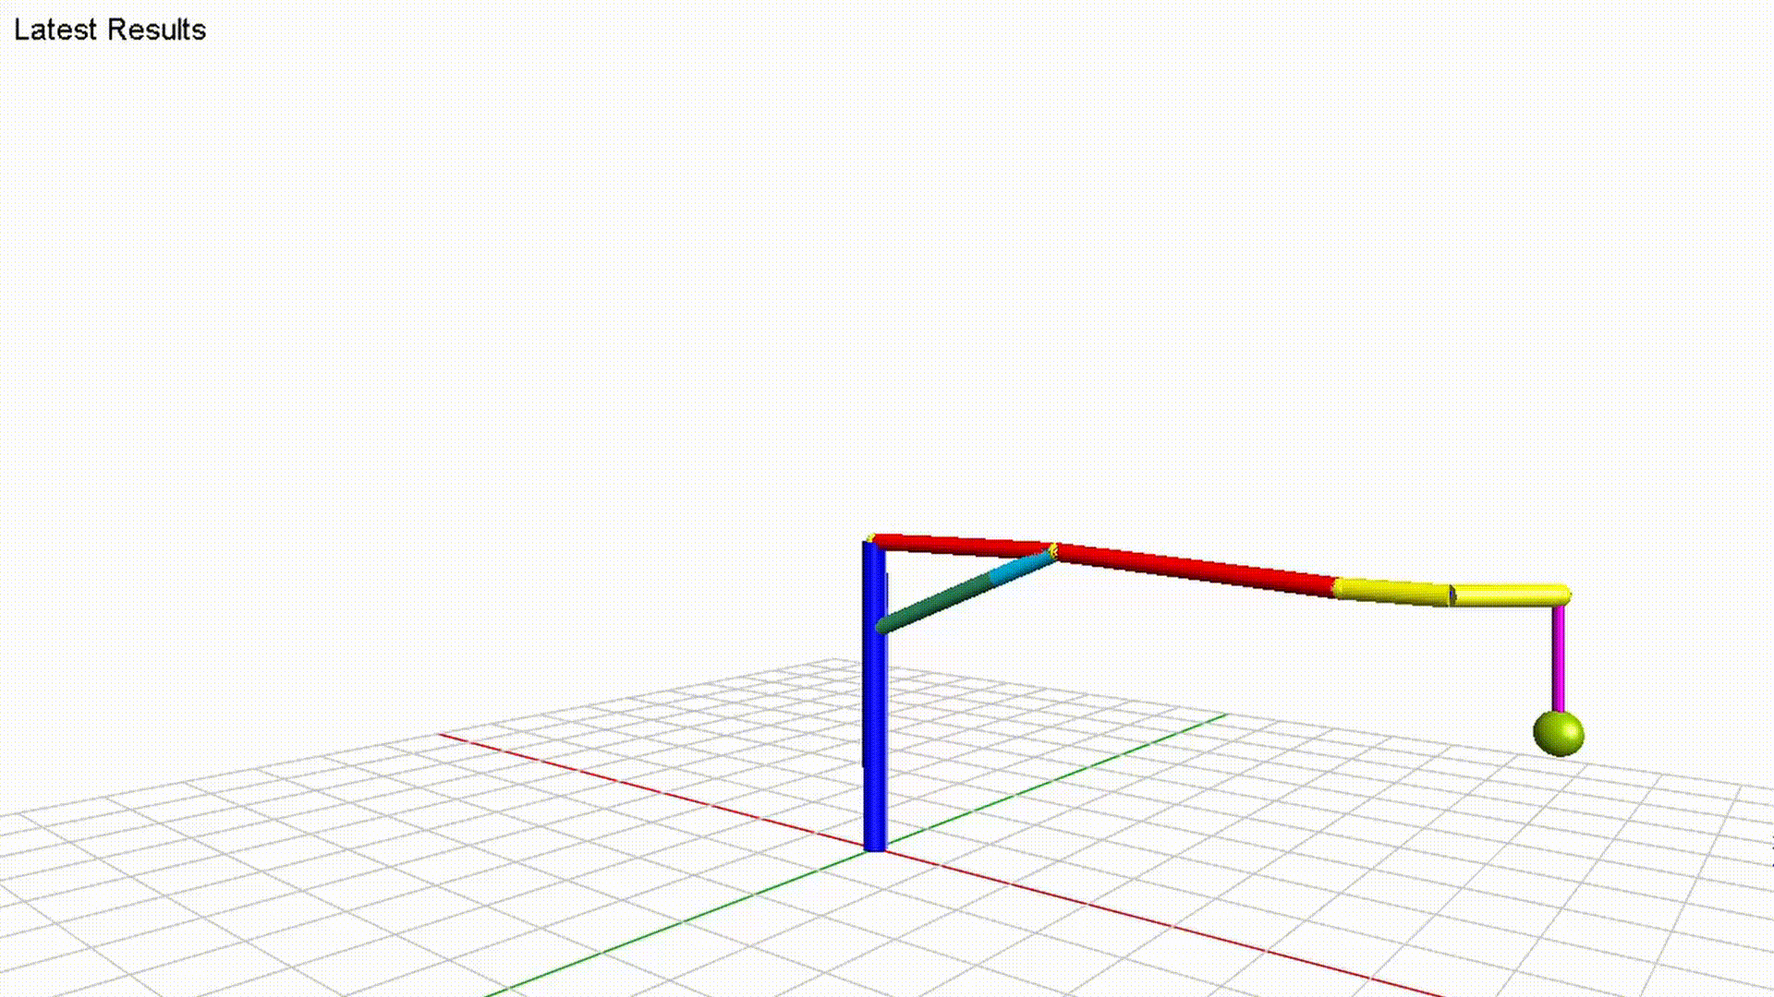
MapleSim Model
We recreated the model in MapleSim using the same geometries, masses and inertias considered for the model in Maple.
The motion profiles imposed at the joints are the same imposed when calculating the forces and torques in the dynamic analysis.

Slide 42
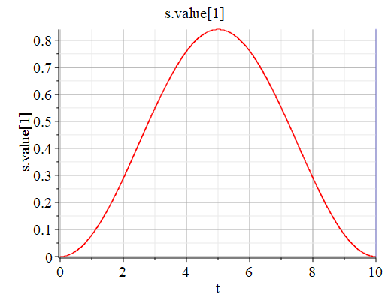
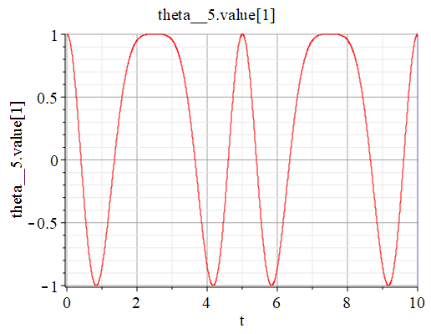


MapleSim Model -
Joints motion

Slide 43

Desired position plots

Slide 44

MapleSim Model - position plots

Slide 45

Desired velocity plots

Slide 46

MapleSim Model - velocity plots

Slide 47

Desired acceleration plots

Slide 48

MapleSim Model - acceleration plots

Slide 49

Desired acceleration plots

Slide 50

MapleSim Model - acceleration plots

Slide 51


MapleSim Model - DAE
Gravity on Y
Gravity on Z

Slide 52
Limits and problems
Limits of our simulation:
The masses are considered as concentrated in the center of mass, and consequently also the inertias are simplified
We did not consider friction in our model
We just considered 1 arm and 1 seat
Problems we have:
The results of the inverse dynamic diverge from the profile we expected
We did not manage to solve the DAEs exported from the MapleSim model (with the correct gravity configuration)
Matlab solution obtained using the motor profiles of the joints even if we get similar results for both methods (projection and Baumgarte)

Slide 53

Thank you
All the code is available at https://github.com/MesSem/Modeling2020
We Did It Song

